Slide 1

ACE - WOMEN SAFETY APP
ARKA SAHA, ESHITHA VIMALAN, YASH JAIN, LAKSHAY BALANI
YOUR SAFETY, OUR RESPONSIBILITY

Slide 2

PROBLEM STATEMENT

Slide 3
Women Safety Analytics
Protecting Women from safety threats

Slide 4
INTRODUCTION

Slide 5

ACE
INTRODUCTION
As Kolkata reels from the horrific rape and murder of a resident doctor at a government-run hospital, the relentless string of similar atrocities raises a haunting question: will this cycle of violence ever be broken, or can we at least hope to reduce its frequency?
App Logo

Slide 6
KEY FEATURES

Slide 7

AI Based voice recognition
🗣️
Features
🧠
Recognises certain keywords assigned by user and triggers the app
Interpreting distress signals through voice with Responsible AI

Slide 8

TRIGGER BUTTON
FEATURES
Pressing power button thrice will trigger the application
Comes handy in vulnerable situations
Caption

Slide 9


LIVE LOCATION SHARING
FEATURES
Share live location with your friends and family members
Sends live location to nearby Police Stations when app is triggered

Slide 10

PRE-RECORDED CONVERSATIONS
FEATURES
We provide realistic pre-recorded conversations
It provides a sense of having company while travelling alone through any means of transport

Slide 11
PROOF OF CONCEPT

Slide 12

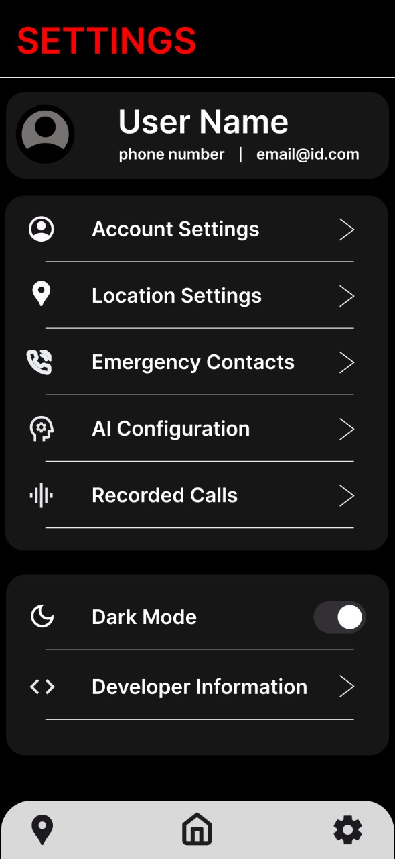
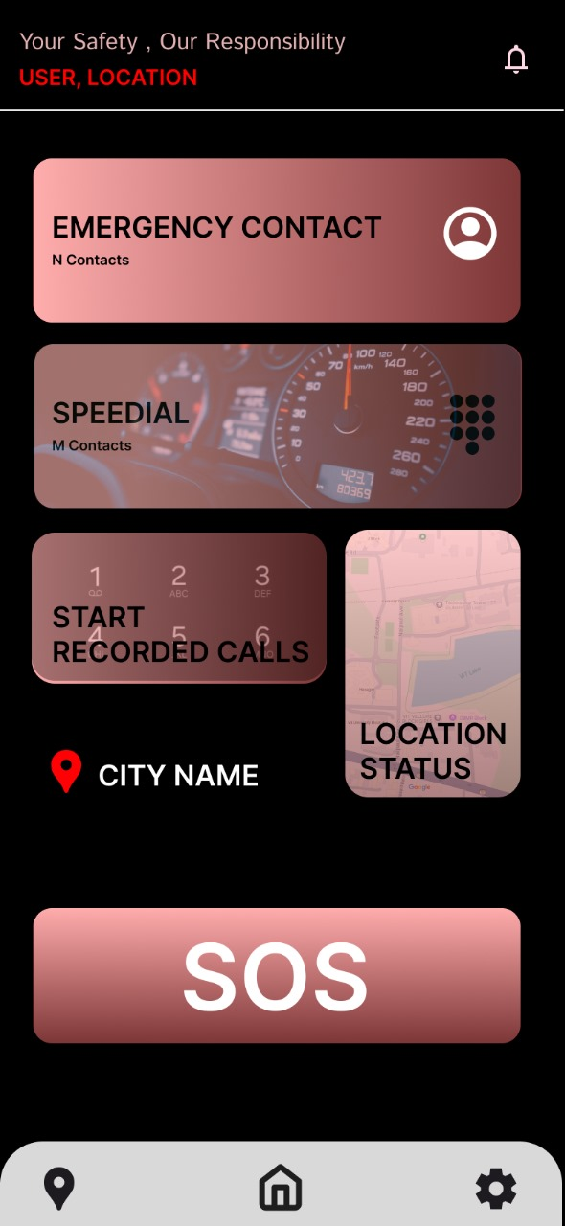
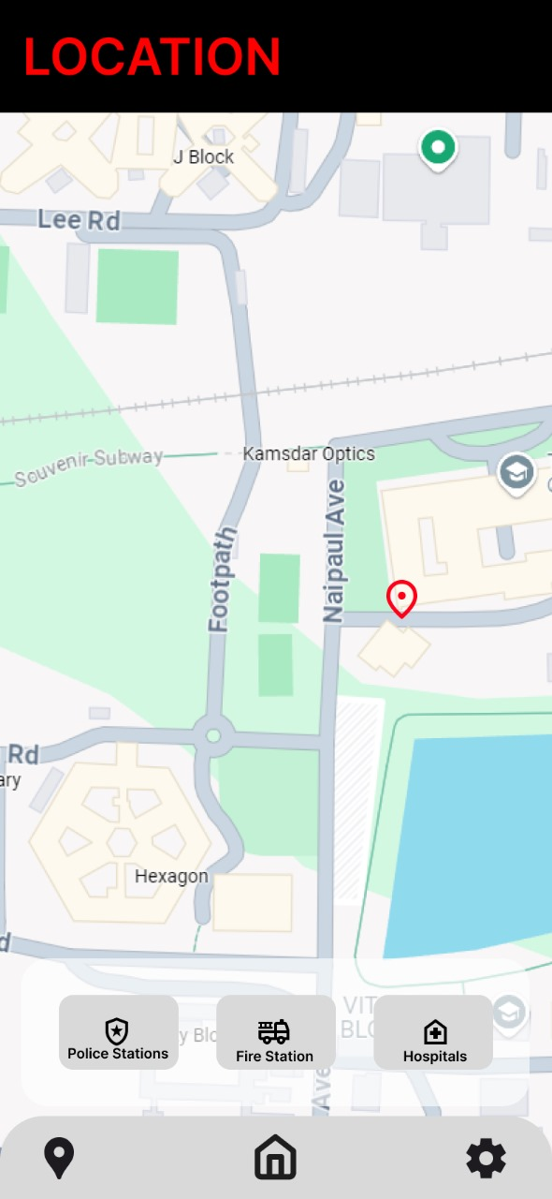
SETTINGS
HOME
LOCATION

Slide 13
WHATS NEXT?

Slide 14

Integrating into a hardware device
WHATS NEXT?
We will integrate our application in to a Raspberry Pi Zero
The device can be installed in different transportation modes

Slide 15
THANK YOU
TEAM MEOW

